Slide 1
Introduction to
International Business Administration

Slide 2
Global Marketing
Notes:
This is a test

Slide 3
Prof. Dr. Amit Shah
Notes:
This is a test

Slide 4
Global Marketing
Marketing mix variables:
product-place (distribution)-promotion-price
Among different countries, why and how:
  It makes sense to vary the attributes of products
  Distribution strategy may vary
  Advertising and promotion strategies may vary
  Pricing strategy may vary
How globalization affects new-product development

Slide 5
Levitt, 1983
“A powerful force drives the world toward a converging commonality, and that force is technology”
(Theodore Levitt, 1983)

Slide 6
Globalization of Markets?
Levitt’s “Converging commonality” has not happened universally
Consumer product tastes converged less than industrial product specifications
Media, communications means have
  made consumers world-wide more aware of their mutual preferences (example: Food products)
  have contributed to creation of world brands (Example: Nike and Apple)
  have caused market segments to emerge across some national markets--inter-market segments (Example: common values among teens)

Slide 7
Market Segmentation
The process of identifying groups of consumers whose purchasing behavior is unique in important ways
  Is based on demography, geography, social-cultural factors, etc.
  It means that firms adjust their marketing mix to meet the needs of separate market segments

Slide 8
Market Segmentation Globally
Standardization: companies may
  Offer same products
  Adjust balance of marketing mix to market segments with similar needs across countries
Adaptation: companies may
  Offer different products
  Adjust balance of marketing mix to market segments with differing needs across countries

Slide 9
International Marketing Mix: Product
Product: a bundle of attributes
  Hamburger: meat type, taste, texture, size
  Automobile: power, design, quality, performance, comfort, size/capacity, number of cup holders, etc.
  Not only actual product but packaging, name, etc.
Products sell well when attributes match consumer needs.
Attributes need to be adapted to a greater or lesser extent to satisfy
  Consumer preferences/tastes due to culture (Hamburgers)
  Economic development levels affect consumer behavior
  Product/technical standards set by governments (Smart car)

Slide 10
Product Attributes
Economic Development
  Consumers in highly developed countries tend to demand a lot of extra performance attributes in their products.
  Consumers in less developed nations tend to prefer more basic products.
  Contrary to Levitt’s suggestions, consumers in most developed countries are not willing to sacrifice preferred attributes for lower prices.
Notes:
Consumers in the most advanced countries often shun globally standardized products that have been developed with the lowest common denominator in mind. They are willing to pay more for products that have additional features and attributes customized to their tastes and preferences. For example, demand for top-of-the-line four-wheel-drive sport-utility vehicles—such as Chrysler’s Jeep, Ford’s Explorer, and Toyota’s Land Cruiser—has been largely restricted to the United States.

Slide 11

International Marketing Mix: Product
Example: in some countries with low literacy, they want a picture of the contents on food containers. Gerber baby food has a picture of a baby on the label.

Slide 12
International Marketing Mix: Place
Optimal channel a company chooses to deliver the product or service, i.e. how do you get it to the customer?
Distribution channels may vary dramatically across countries
  Retail system: concentrated or fragmented
  Channel length: long, short, difficulty in transport
  Channel exclusivity: one channel or many?
May depend upon custom, culture, level of economic development, etc.

Slide 13
Distribution Strategy
Differences between Countries
  Retail Concentration.
    In a concentrated system, a few retailers supply most of the market.
    In a fragmented system, there are many retailers, none of which has a major share of the market.
Notes:
There is a tendency for greater retail concentration in developed countries. Three factors that contribute to this are the increases in car ownership, the number of households with refrigerators and freezers, and the number of two-income households.
In contrast, retail systems are very fragmented in many developing countries, which can make for interesting distribution challenges.

Slide 14
Distribution Strategy
Differences between Countries continued
  Channel Length.
    The number of intermediaries between the producer and the consumer.
      When the producer sells directly to the consumer, the channel is very short.
      When the producer sells through an import agent, a wholesaler, and a retailer, a long channel exists.
    Fragmented retail systems tend to have longer channels.
      Example: Japan.
    Entry of large discount superstores is shortening channel length in some countries.
Notes:
When the retail sector is very concentrated, it makes sense for the firm to deal directly with retailers, cutting out wholesalers. A relatively small sales force is required to deal with a concentrated retail sector, and the orders generated from each sales call can be large. Such circumstances tend to prevail in the United States, where large food companies may sell directly to supermarkets rather than going through wholesale distributors.

Slide 15
Distribution Strategy
Differences between Countries continued
  Channel Exclusivity.
    An exclusive distribution channel is one that is difficult for outsiders to access.
    Retailers usually prefer to carry products from established manufacturers.
      Japan's system is an example of a very exclusive system.
Notes:
In Japan, relationships among manufacturers, wholesalers, and retailers often go back decades. Many of these relationships are based on the understanding that distributors will not carry the products of competing firms.

Slide 16
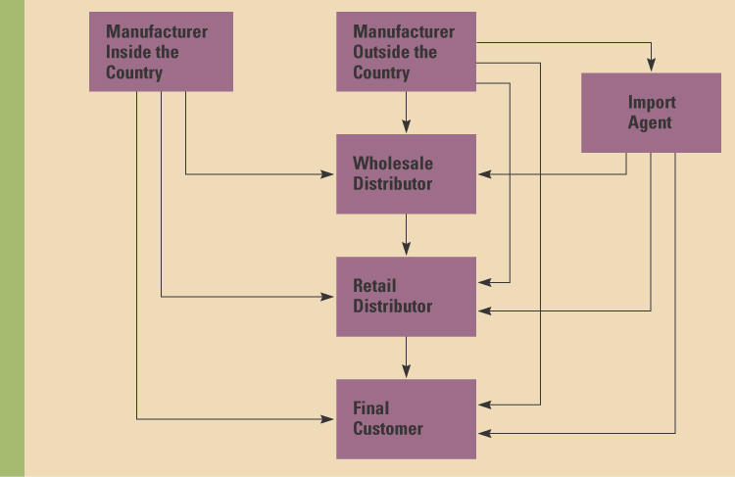
Typical Distribution System
Notes:
A firm’s distribution strategy (the means it chooses for delivering the product to the consumer) is a critical element of the marketing mix. If the firm manufacturers its product in the particular country, it can sell directly to the consumer, to the retailer, or to the wholesaler. The same options are available to a firm that manufactures outside the country, or the firm could sell to an import agent.

Slide 17
International Marketing Mix: Promotion
How firm communicates the product attributes / benefits to customers, i.e., convinces them to buy
Barriers to international communication
  Cultural differences
  Country of origin effects, home-grown or import?
  Noise levels, i.e. too much information
  Level of development (e.g. literacy, technology)
  Language

Slide 18
International Marketing Mix: Promotion
  Use push strategies:
    For industrial products or complex new products.
    When distribution channels are short.
    When few print or electronic media are available.
  Use pull strategies:
    For consumer goods products.
    When distribution channels are long.
    When sufficient print and electronic media are available to carry the marketing message.
Notes:
Company goes to the customers one on one → larger contracts; something you cannot really advertise

Slide 19
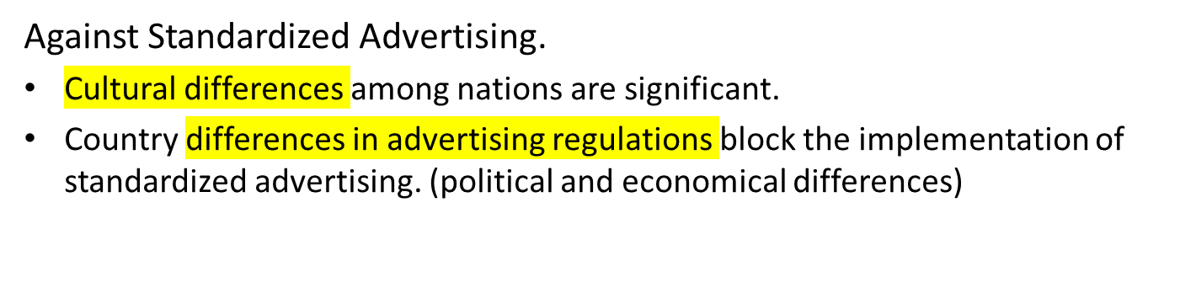
International Marketing Mix: Promotion
Global Advertising
  For Standardized Advertising.
    Significant economic advantages.(billiger)
    Creative talent is scarce—one large effort to develop a campaign will be more successful than many smaller efforts.
    Brand names are global.
Notes:
One of the most successful standardized campaigns in history was Philip Morris’s promotion of Marlboro cigarettes. When the brand was repositioned, the idea was to ensure smokers that Marlboro cigarettes would maintain the customary flavor. The campaign theme of “Come to where the flavor is: Come to Marlboro country” was a worldwide success some time ago. Marlboro built on this when it introduced “the Marlboro man,” a rugged cowboy smoking his Marlboro while riding his horse through the great outdoors. This ad proved successful in almost every major market around the world, and it helped propel Marlboro to the top of the world market.

Slide 20
International Marketing Mix: Price
Some factors to consider in pricing in new markets:
One price around the world (or region) or different prices in different places Will customers know you have different prices?
What can customers afford? (example: Pharmaceutical drugs)
    What is the level of economic development?
    What is your target market?
How important is your product to the customers?
    Is it a ‘must have’ or a luxury?
Regulatory issues: antidumping, monopoly restrictions

Slide 21
End of Marketing Lecture

